Slide 1
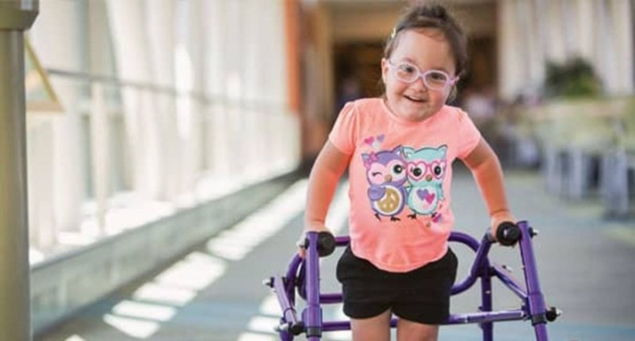
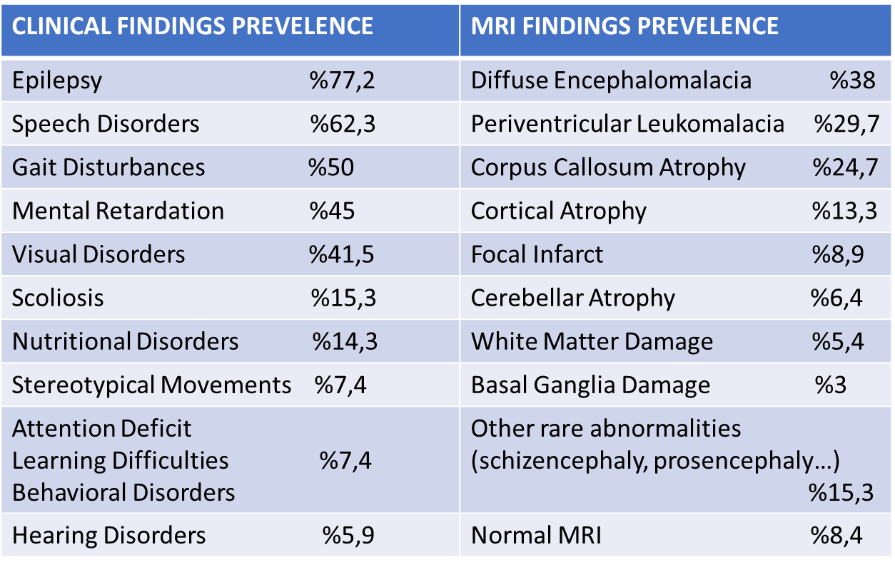
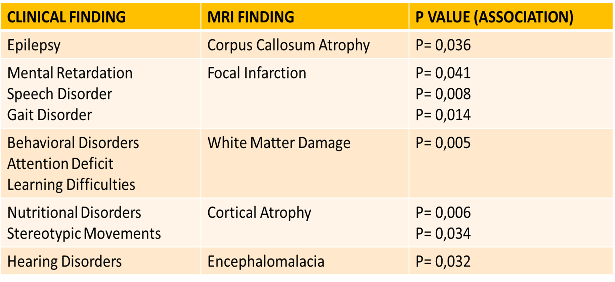
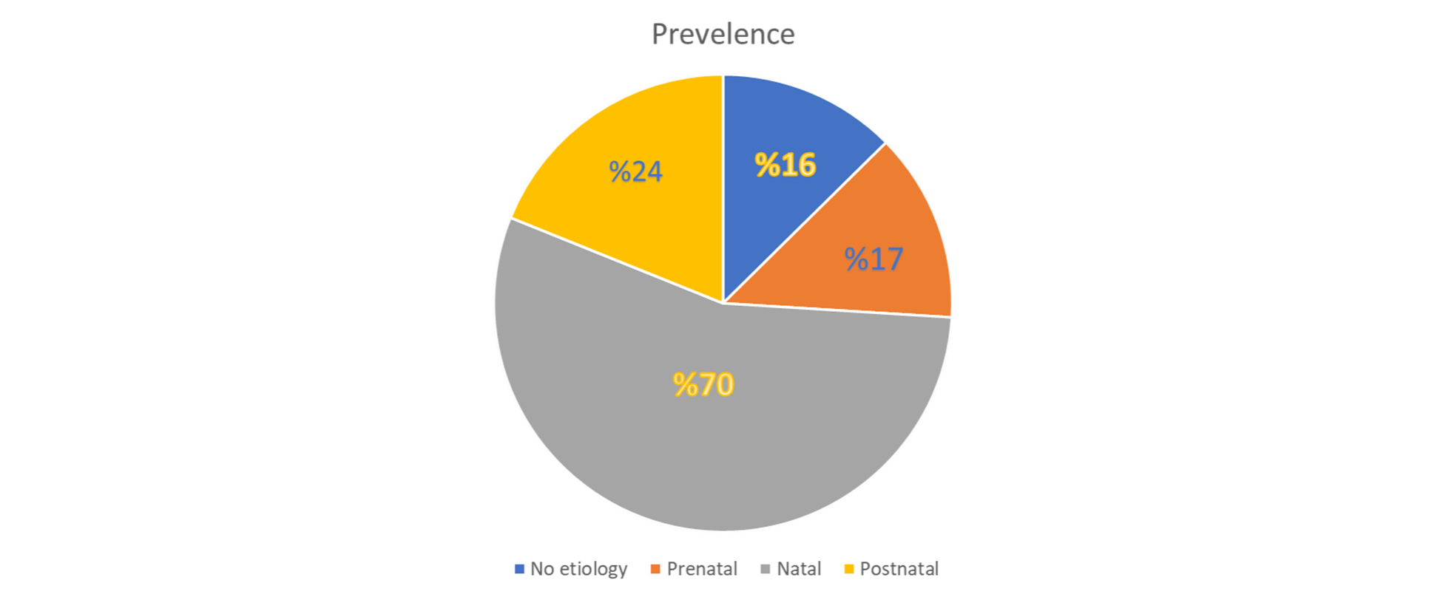
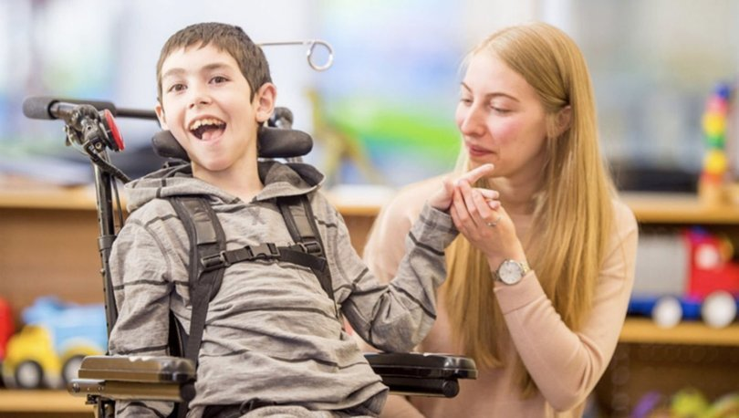
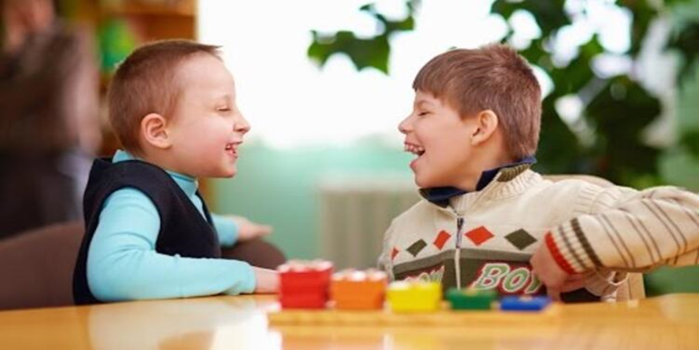
ANALIZING THE RELATIONSHIP BETWEEN BRAIN MAGNETIC RESONANCE
IMAGING FINDINGS AND CLINICAL FINDINGS IN CHILDREN WITH CEREBRAL PALSY
Canan Koban¹ , Füsun Dilara İçağasıoğlu²
¹Bezmialem Vakıf University, Faculty of Medicine, Istanbul, Turkey.
²Bezmialem Vakıf University, Faculty of Medicine, Department of Pediatric Neurology ,Istanbul, Turkey.
INTRODUCTION
Cerebral palsy (CP) is a non-progressive neurodevelopmental disorder that occurs in the fetal brain, causing loss of motor function, movement and posture. CP may develop due to many factors in prenatal, natal or early postnatal period. Except these three periods, it may be said that consanguineous marriage is one of the important reason that may cause CP. The wait-and-see approach is remarkable in high-risk babies, as definitive biological markers may not be identified in the diagnosis of CP. However magnetic resonance imaging (MRI) may relatively provide information about the nature and timing of brain lesions.The aim of this study was to evaluate the association between cranial MRI findings and clinical comorbidities of CP.
METHODS
This study was carried out retrospectively in Bezmialem Vakıf University Medical Faculty Hospital Pediatric Neurology Outpatient Clinic after approval of the Ethics Committee. 202 patients who were newly diagnosed or followed up between January 2017 and August 2020 were included but however, cases with a progressive course were excluded from the study. The demographic informations, prenatal, natal and postnatal histories, consanguineous marriage, clinical findings and MRI results of the patients in the archive were recorded in detail.
RESULTS
Cranial MRI abnormalities were detected in 91.5% of the patients. According to the data obtained, the most common clinical finding was determined as epilepsy (77.2%) and observed that epilepsy frequently accompanies corpus callosum atrophy (p = 0.036). We found that mental retardation, speech disorders and gait disorders were associated with focal infarction and a significant correlation was found between them (p = 0.041, p = 0.008, p = 0.014).It was learned that clinical findings such as behavioral disorders, learning difficulties and attention deficit were associated with white matter damage (p = 0.005). We found significant correlation in between nutritional disorders and cortical atrophy (p = 0.006). Except for nutritional disorders, the association of stereotypic movements with cortical atrophy was remarkable. (p = 0.034).
CONCLUSION
It has been found that many of the clinical findings seen in cerebral palsy are significantly related to the damaged area of the brain. With the help of patients detailed histories and MRI, it may be predicted and prevented which clinical finding may accompany to child with CP.
REFERENCES
1. Bax M, Goldstein M, Rosenbaun P, Leviton A, Paneth N, Dan B, et al. Proposed definition and classification of cerebral palsy, April 2005. Vol. 47, Developmental Medicine and Child Neurology. 2005. p. 571–6.
2. Legault G, Shevell MI, Dagenais L. Predicting comorbidities with neuroimaging in children with cerebral palsy.Pediatr Neurol. 2011;45(4):229–32.
3. Prasad R, Verma N, Srivastava A, Das BK, Mishra OP. Magnetic resonance imaging, risk factors and co-morbidities İn children with cerebral palsy. J Neurol. 2011;258(3):471–8.
4. Wimalasundera N, Stevenson VL. Cerebral palsy. Vol. 16, Practical Neurology. 2016. p. 184–94. 4. Ali A, Yalçın R, Ünlüer-Gümüştaş A. Cranial MR characteristics of Cerebral Palsy cases and correlation of findings with clinical results. The Turkish Journal of Pediatrics. 2019; 61(4)
5. Korzeniewski SJ, Birbeck G, DeLano MC, Potchen MJ, Paneth N. A systematic review of neuroimaging for cerebral palsy. Vol. 23, Journal of Child Neurology. 2008. p. 216–27.
6. Cioni G, Sales B, Paolicelli PB, Petacchi E, Scusa MF, Canapicchi R. MRI and clinical characteristics of children with hemiplegic cerebral palsy. Neuropediatrics. 1999;30(5):249–55.
7. Badawi N, Watson L, Petterson B, et al. What constitues cerebral palsy? Dev Med Child Neurol. 1998;40:520-527.

